Slide 1

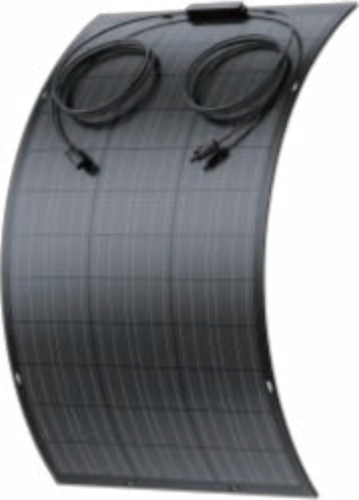
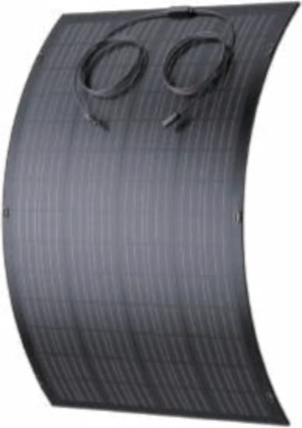
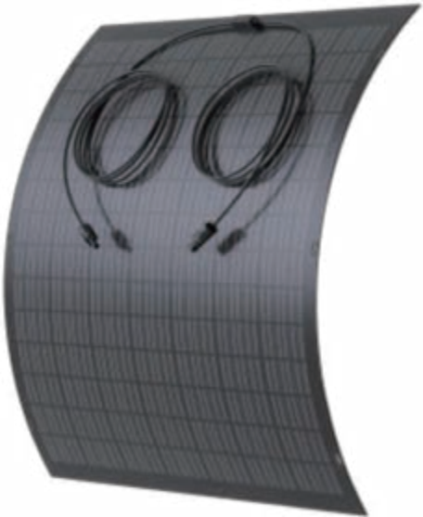

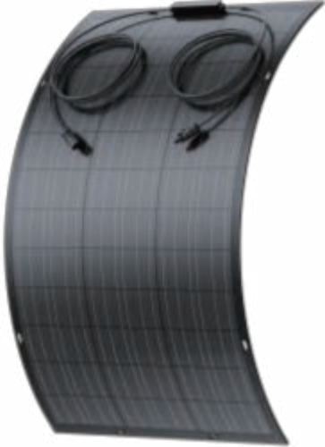
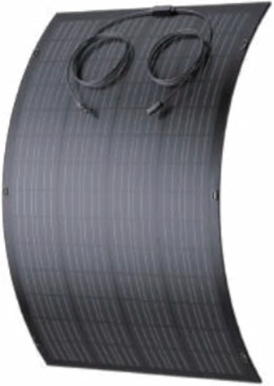
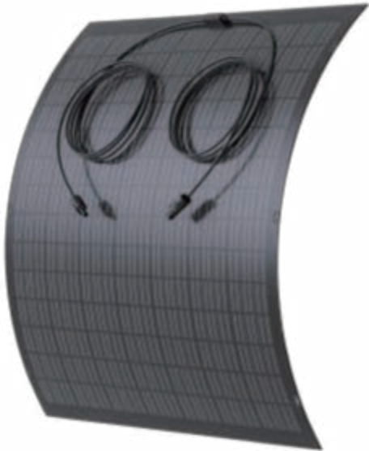



120/200/240W
power rating | 120W | 200W | 240W
open-circuit voltage (voc) | 26V | 1 8 . 36V | 23 . 6V
short-circuit current (Isc) | 5 . 77A | 1 3 . 51A | 1 1 . 9A
Maximum power voltage (vm) | 22 . 02V | 1 5 . 66V | 21 . 01V
Maximum power current (Im) | 5 .45A | 1 2 . 78A | 1 1 . 235A
Maximum series fuse | 10A | 1 5A | 20A
size | 1090mm x 592mm | 1160mm x 940mm | 1150mm x 1090mm
weight | 1 . 6kg | 3 . 98kg | 2 . 6kg
cable and plug connector | 2 x 3000mm / 2 . 5mm2 | 2 x 3000mm / 2 .5mm2 | 2 x 3000mm / 2 .5mm2
Transfer efficiency | ≥ 1 8 . 66% | ≥ 1 8 . 34% | ≥ 1 8 . 66%
Levels of protection | IP67 | IP67 | IP67
Maximum system voltage | 600V/DC | 600V/DC | 600V/DC
certificate | CE , IEC , ROHS | CE , IEC , ROHS | CE , IEC , ROHS
120W
200W
240W

